Slide 1
Building Block View
Software Architecture

Slide 2
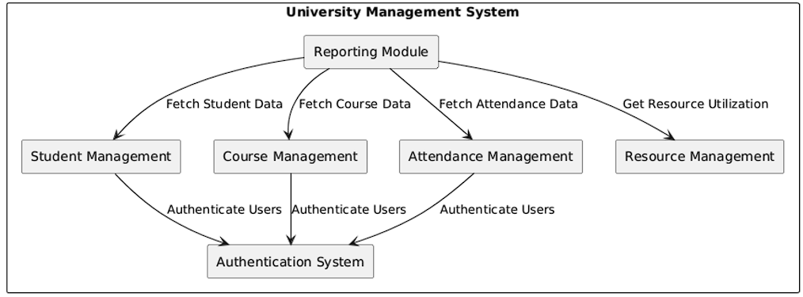
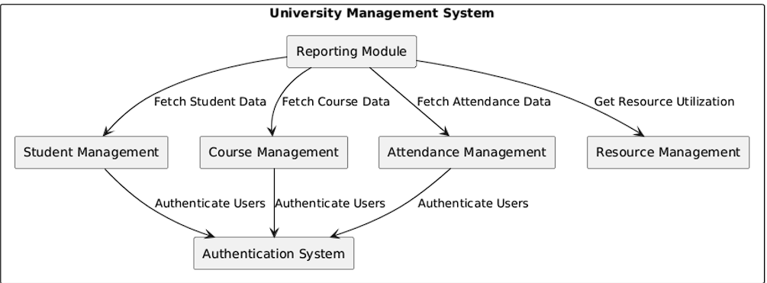
Level 1
Maintain an overview of your source code by making its structure understandable through abstraction.This allows you to communicate with your stakeholder on an abstract level without disclosing implementation details.
Level 1 is the white box description of the overall system together with black box descriptions of all contained building blocks.
Level 2 zooms into some building blocks of level 1. Thus it contains the white box description of selected building blocks of level 1, together with black box descriptions of their internal building blocks.
Level 3 (not shown in the diagram above) zooms into details of selected building blocks of level 2, and so on.
Define three levels of your software. Focus on important components for level 2 and 3.
Help: https://docs.arc42.org/section-5/ & https://biking.michael-simons.eu/docs/index.html#section-building-block-view

Slide 3
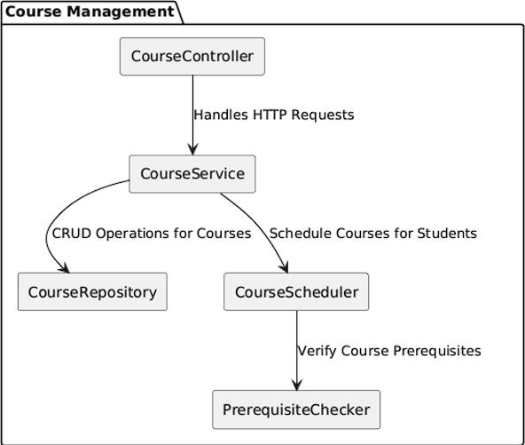
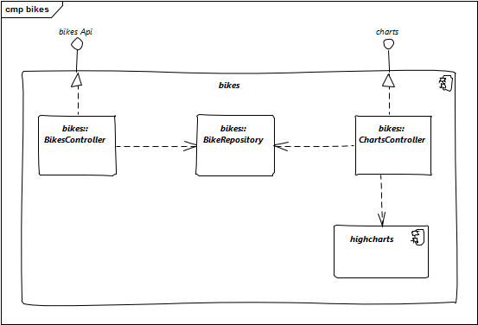
Level 2

Slide 4
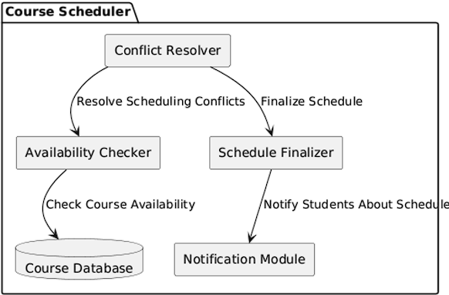
Level 3

